Slide 1

Sprocket Central Pty Ltd
The Analytic Team

Slide 2
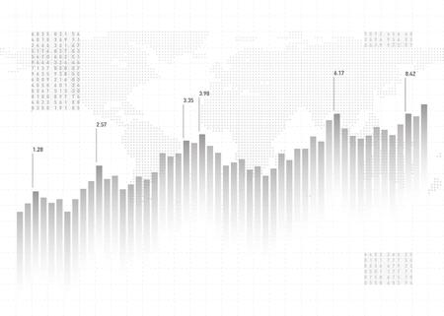
OUTLINE
Project Description
Data Quality Assessment
Data Insights
Summary Dashboard
3
4
5
10

Slide 3
PROJECT DESCRIPTION
Background, Context and Problem.
Sprocket Central Pty Ltd , a medium size bikes & cycling accessories organization want to analyze large dataset relating to its customers to help optimize its marketing strategy.
Therefore, the problems that this project will solve are:
1. What are the trends in the underlying data?
2. Which customer segment has the highest customer value?

Slide 4
DATA QUALITY ASSESSMENT
Dataset | Accuracy | Completeness | Consistency | Currency | Relevancy | Validity | Uniqueness
Customer Demographics | Wrong Value: DOB, Gender. | Missing Value: Last Name, DOB, Job Title, job Industry, Tenure. | Format: Gender. | - | Irrelevant: Default. | Data type: DOB. | -
Customer Address | - | - | Format: State. | - | - | - | -
Last three months transactions (Transactions) | New Column: Profit (Price-Cost). | Missing Value: Online Order, Brand, Product Line, Product Class, Product Size, Standard Cost, Product First Sold Date. | - | - | - | Data type: Transaction Date, Product First Sold Date, Price and Standard Cost. | -
Accuracy : Correct Values
Completeness : Data Fields with Values
Consistency : Values Free from Contradiction
Currency : Values up to Date
Relevancy : Data Items with Value Meta-data
Validity : Data Containing Allowable Values
Uniqueness : Record that are Duplicated

Slide 5
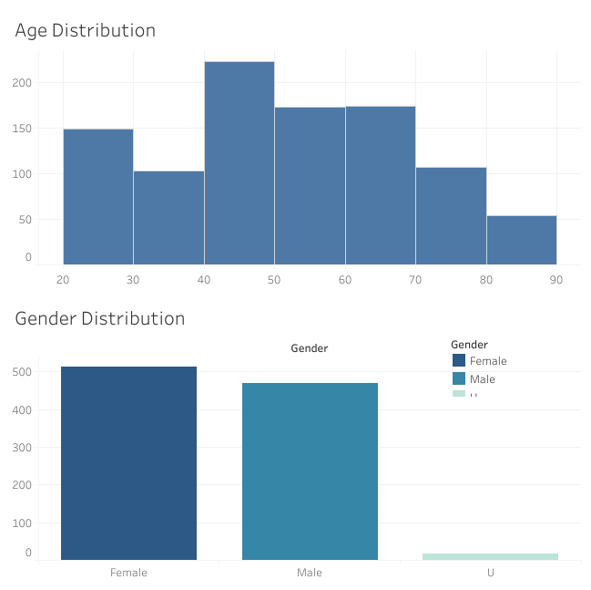
DATA INSIGHTS
Data Exploration
Customer Characteristics
Gender & Age Distribution
Majority customers is Female
Difference between Male and Female customers is 33.
Majority group age of customer is 40-60 years old.
17 data has DOB null values.

Slide 6
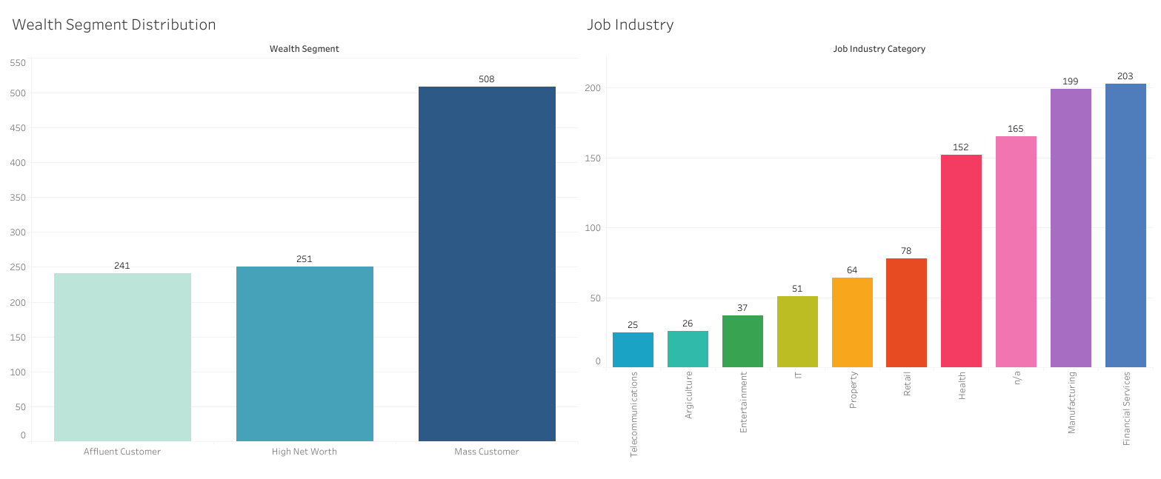
DATA INSIGHTS
Data Exploration
Customer Characteristics
Wealth Segment & Job Industry Distribution
Customer segments dominated by Mass Customer.
Mass Customers percentage is about two times Affluent/High Net Worth Customer.
Data has many uncategorized job industry (165 customers)

Slide 7
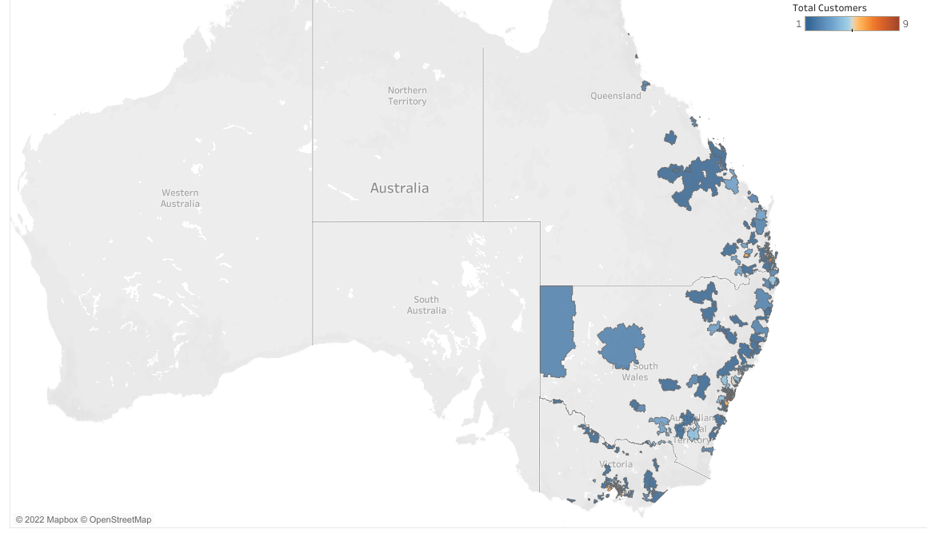
DATA INSIGHTS
Data Exploration
Customer Characteristics
Map
Consumers are centered in each area close to the state capital and the market only covering Eastern Australia.

Slide 8
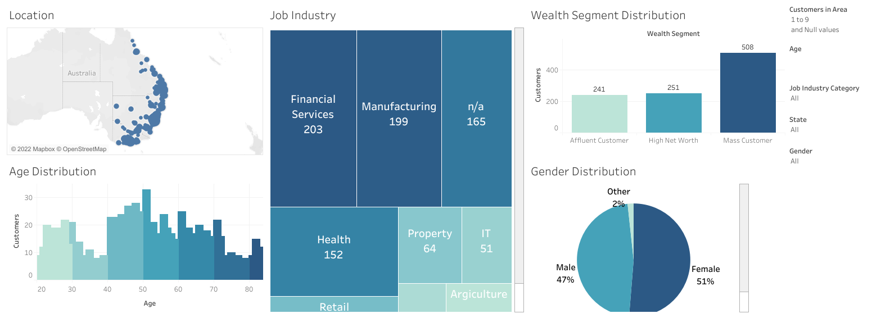
DATA INSIGHTS
Data Exploration
Customer Characteristics
Dashboard
Click this to visit customer characteristics dashboard.

Slide 9
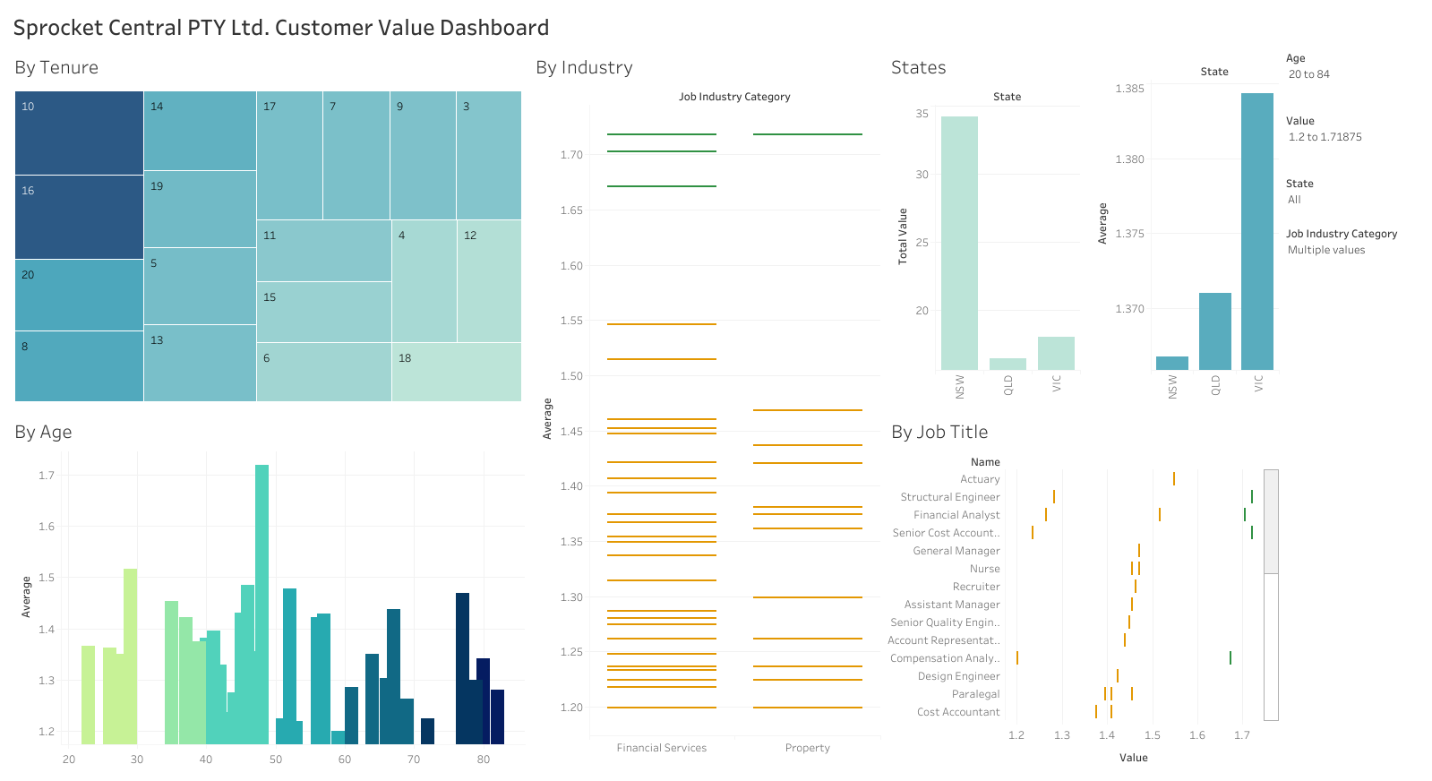
DATA INSIGHTS
Data Exploration
Customers Value
Dashboard
Click this to visit customers value dashboard.

Slide 10
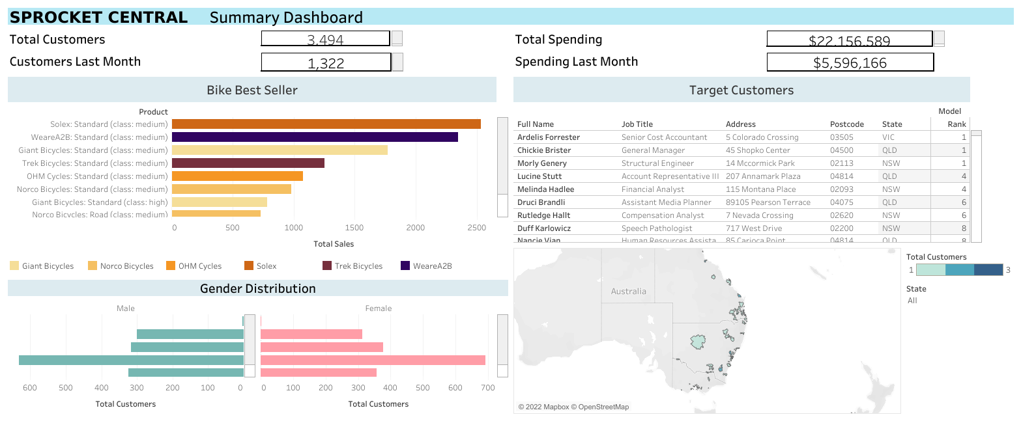
Summary Dashboard
Click this to visit summary dashboard.

Slide 11
Thank You

